Slide 1



Affordability & Housing Conundrum
Storage Saiyans

Slide 2
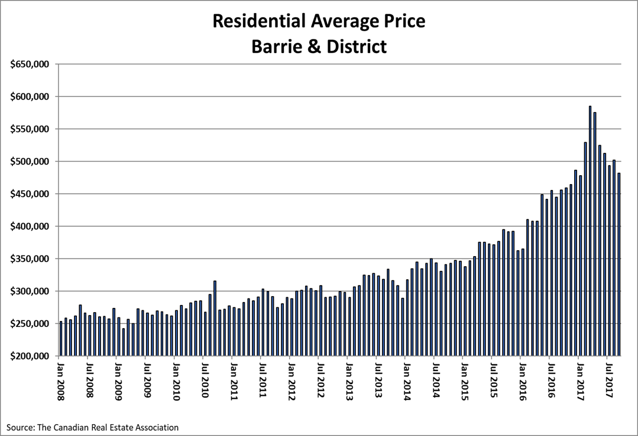
Average House Prices - Barrie
The year-to-date average price figure for homes sold within the City of Barrie was $507,484. This was an increase of 24.8% compared to the average selling price in 2016.

Slide 3
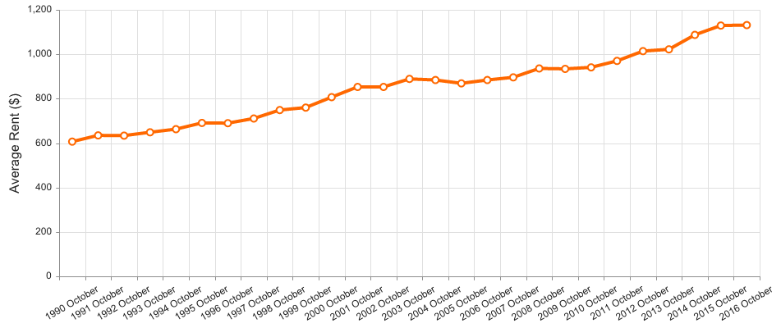
Average House Rent - Barrie
Average Rent in Barrie for 2016 changed by 3.7% over 2015.

Slide 4
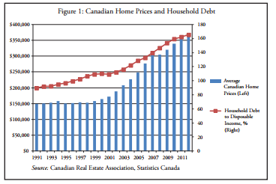
Household Debt
We need the data for the household debt for individuals living in barrie to discover a trend. To corroborate the need for the data the fraction of household debt to disposable income for Canada is plotted alongside average home prices from 1991-2011.
Average Canadian household shows increasing levels of debt over years and almost 80% is housing related.

Slide 5
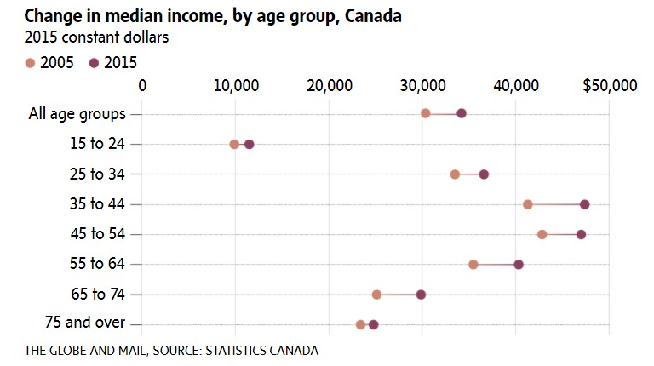
Change In Median Income
The lower income groups have the least change in terms of salary from a period of 2005 – 2015.
Further to note is this study does not take into account the inflation, which equates to the fact that the increase is even shorter.

Slide 6

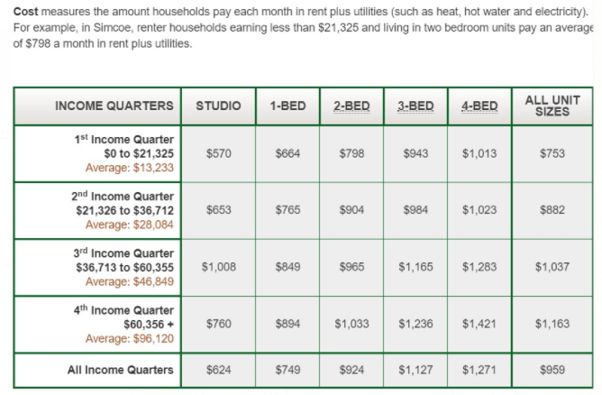
Estimated Rent for Different Household Types

Slide 7
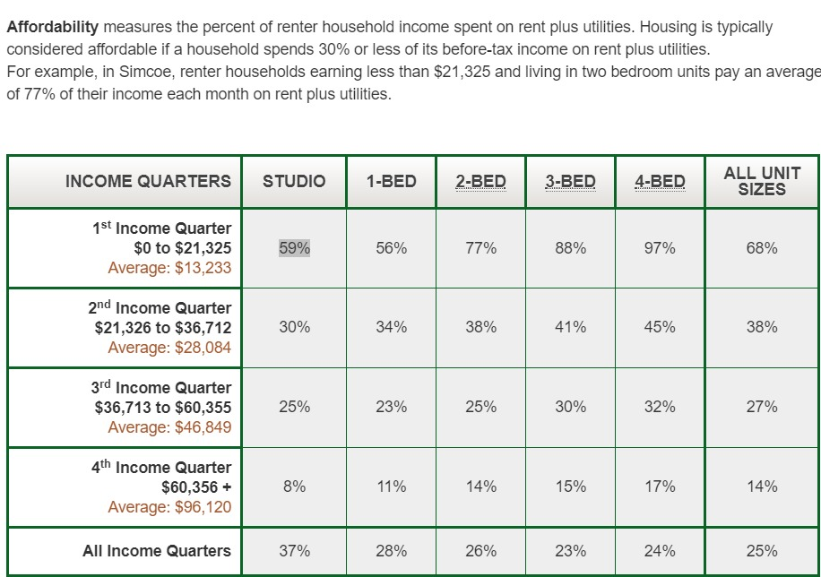
Renters Affordability
Percentage of Monthly Income spent by renters on different household types depending on average income.

Slide 8
TRADITIONAL Definition of Affordability ?
Affordability is defined when a household spends less than 30% of its pre-tax income on adequate shelter.
Household that spend more than 30% of their income are deemed to be in core housing need.
Those who spend 50% or more are in severe housing need.

Slide 9
Affordability Index
Takes into account the Household size, Household income, Household debt, Disposable Income, Number of employed individuals in a household, wealth present/purchasing power, Down Payment Amount (Ownership), Credit rating(Ownership),Lending Institution(Ownership), Unit Type, Transportation.

Slide 10
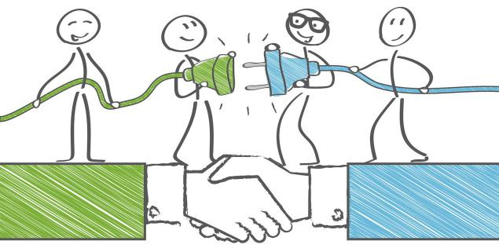
PPP Model
Public–private partnerships (P3s) are a long-term, performance-based approach to procuring public infrastructure that can enhance governments’ ability to hold the private sector accountable for public assets over their expected lifespan.
P3s work because they engage the expertise and innovation of the private sector and the discipline and incentives of capital markets to deliver public Housing projects.
Contract with private party to design and build public facility.
Potential to accelerate construction programme.
Government can be able to control housing projects.

Slide 11

Precast Technology
Precast technology saves a lot of construction time and offers quality, value and speed at the same time.
Not only does it speed up construction, but it also enhances the quality of the final output. This technology reduces construction cost by 10-15%. Also, precast and engineered home material eliminates the need for auxiliary activities like plastering, electrical wiring, etc.
Precast technology is considered investment-friendly; while margins are not going to be affected much, the quality of the product will be enhanced in a big way and delivery of the project can be made within the stipulated time frame.
Precast technology is already being used in Europe, Dubai, Malaysia, Singapore.

Slide 12
Vacant Homes Issue.
How to determine Houses are vacant ?
During the buytime of the property we need to determine whether they are going to occupy the property or not.
Keeping a check on Hydrobills , as the properties are vacant there are no Hydrobills or 0 bills same with the case of internet connections.
We can also increase the vacancy tax so that owners will not favour of keeping their properties vacant.
These unoccupied or vacant properties can be developed and used for affordable housing.
There were as many as 66,000 vacant units in Toronto in 2016.
Many foreign firms invest their money in properties in stable market like Canada and these properties are left vacant.
Controlling this, we can keep control on unoccupied and vacant properties.
We should also create awareness drives and make people aware of such properties where they can rent and suffice their needs.

Slide 13
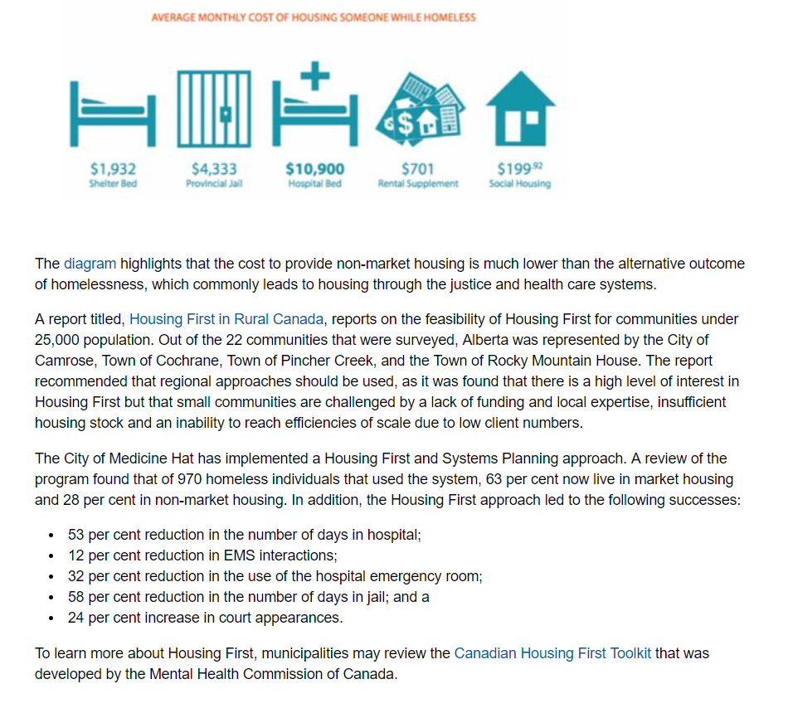
Giving homes to homeless will cause reduced costs on justice and health care systems, and also improve their quality of life.

